Slide 1
Data
Visualization
Basic Concepts
Aula 01:
slide creeds: Dr. Benjamin Bach
Estanislau Lima
08/05/2024
Aula 02:

Slide 2
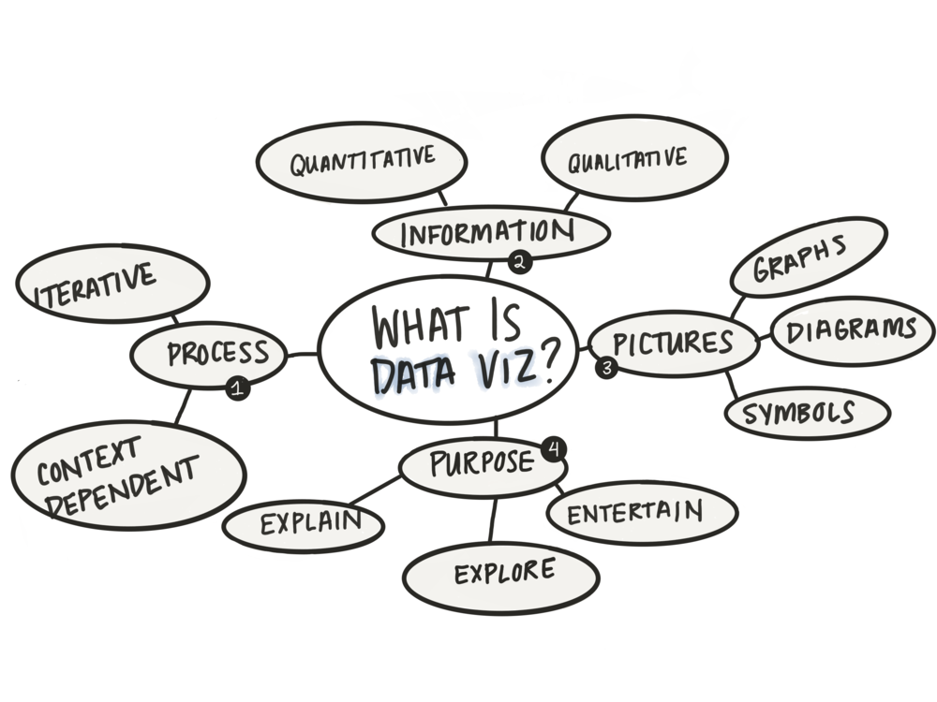

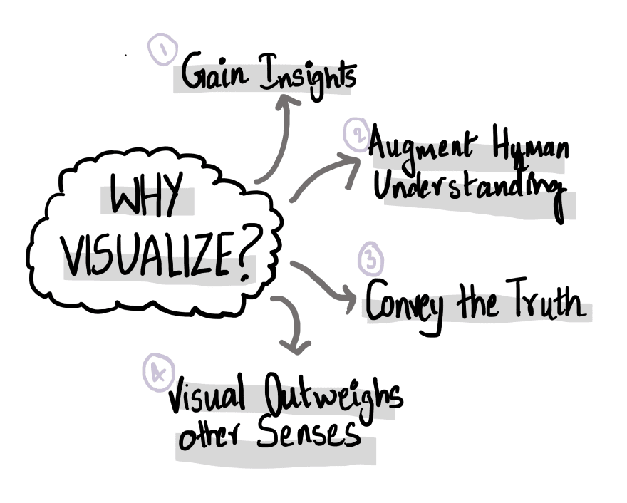
What is visualization? Why Visualize?

Slide 3

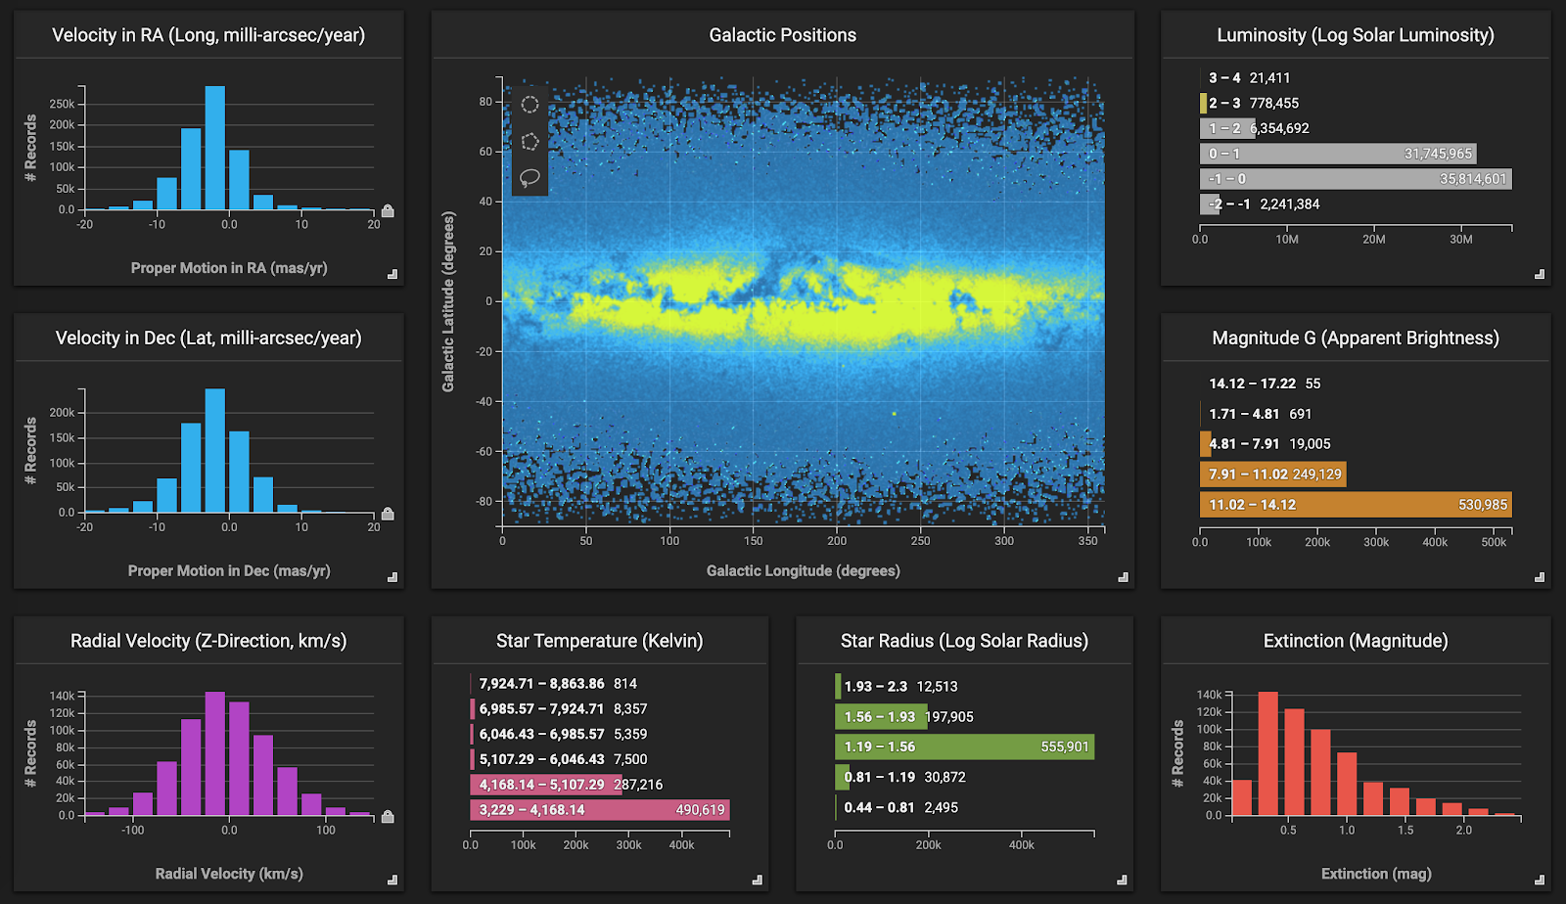
What is visualization?
Data Visualization is the Graphical Representation of Information and Data.
To visually display,
To analyze,
To clarify,
To interpret numerical data, functions, and other qualitative structures.

Slide 4
Types of Graphical Representation
Bar Graph
Choropleth
Flow Chart
Histogram
Line Graph
Pie Chart
Pointmap
Scatter plot
Stacked Bar Timeline
Tree Diagram Venn Diagram

Slide 5




Open source visualization tools
Tableau
Google Charts
Dundas BI
Power BI
JupyteR
Infogram
ChartBlocks
FusionCharts
Grafana

Slide 6
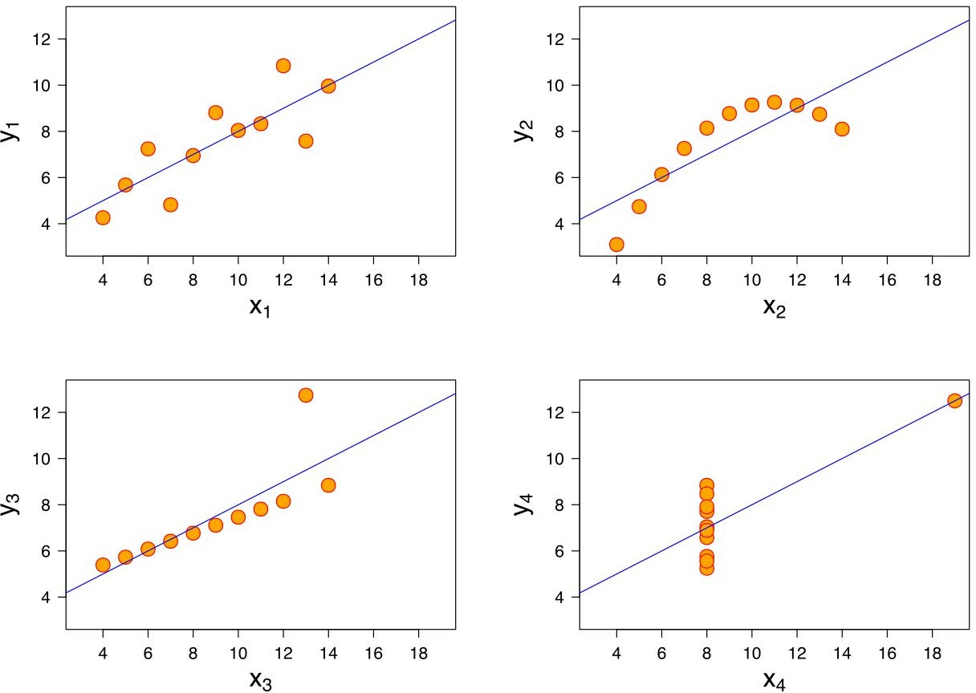
Anscombe's Quartet

Slide 7
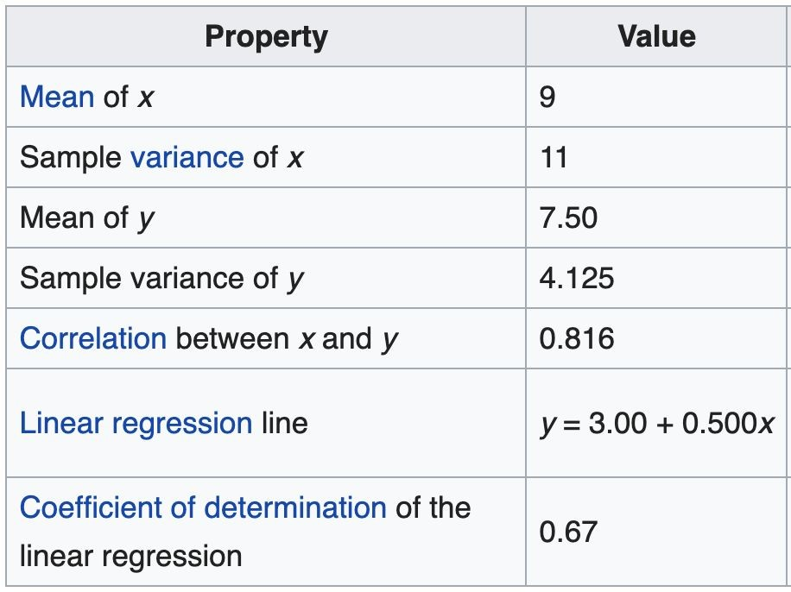
Anscombe's Quartet

Slide 8
(Possible) Definitions
"The use of computer-supported, interactive,
visual representations of
abstract data to amplify cognition"
Stuart Card
..an accessible way to
see and understand
trends, outliers, and patterns in data."
Tableau
... to help people carry out tasks more effectively
Tamara Munzner

Slide 9

Defining Concepts
computer supported
Interactive visual representations
For Abstract data
Helping people
to see and understand
trends, outliers, and patterns in data,
and carry out tasks
more effectively
Through amplifying cognition

Slide 10
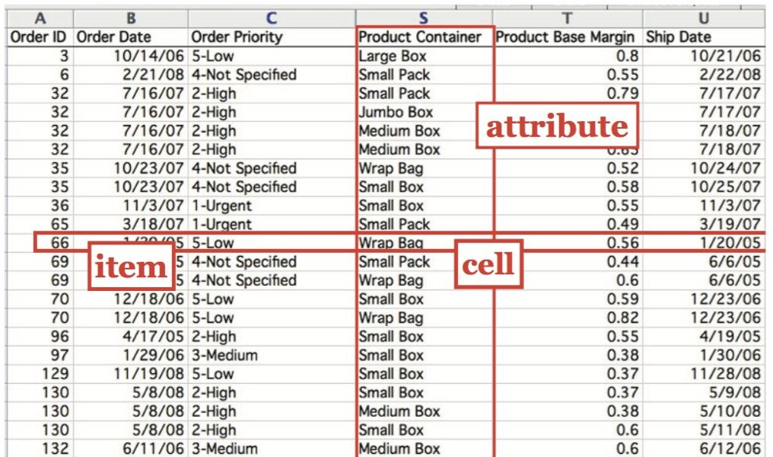


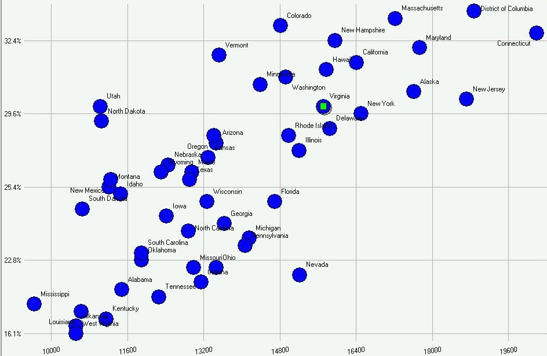
Action
Data
Visualization
Information

Slide 11
Encoding: designer
Decoding: user
Comprehending
What does it mean for me?
What shall I do now? Is this all true?
What do I learn?
1
Data
6
What is my data?
Which data type?
Ordinal / numerical / categorical?
Visual Mapping
What is my visual representation? Which visual variables am I using? How am I encoding my data?
fi
Interpreting
What does it mean? What does color mean? Wha does 'up 'mean?
What do these patterns show?
5
Rendering
What is my medium? monoscopic/stereoscopic? Tangiblity?
Print / digical?
3
4
Perceiving
What does it show?
Where is big, medium, small? How do things compare?
What relationships exist?
View

Slide 12
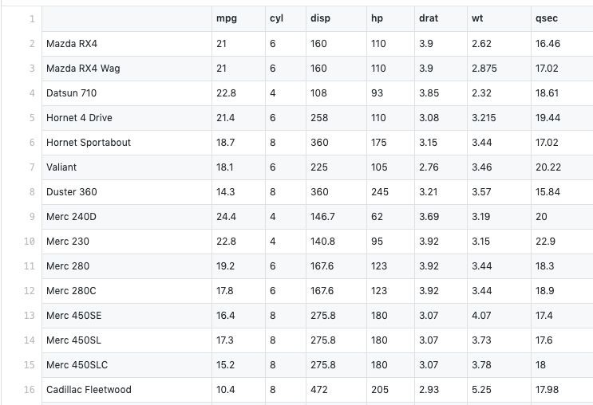
1. Data
Value
Attribute
Item

Slide 13
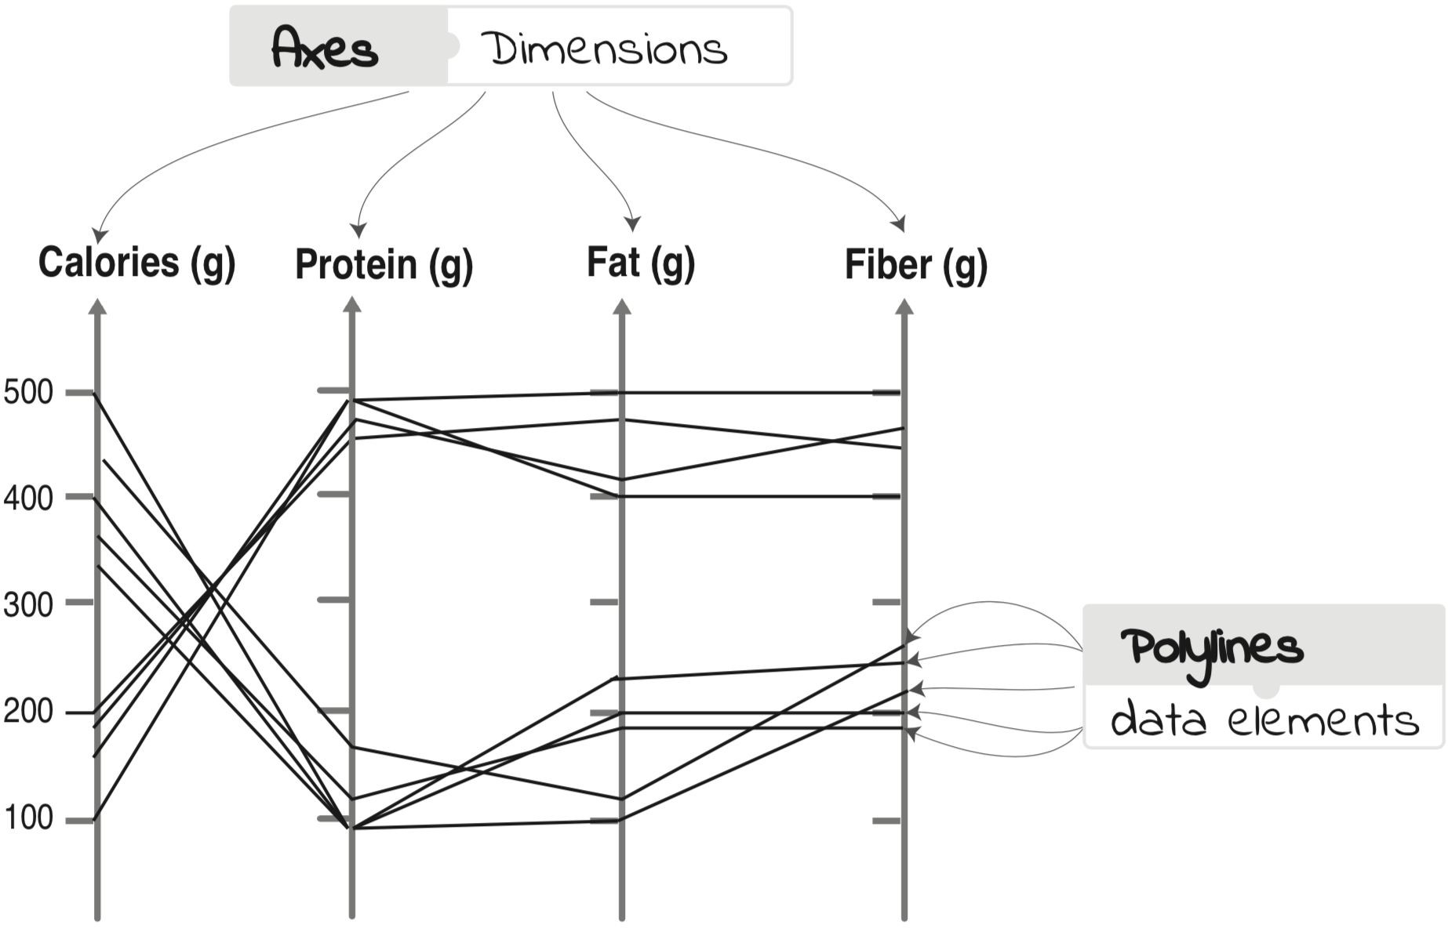


2. Visual Mapping
A
B
C
D
+
Visual Representation
Data

Slide 14
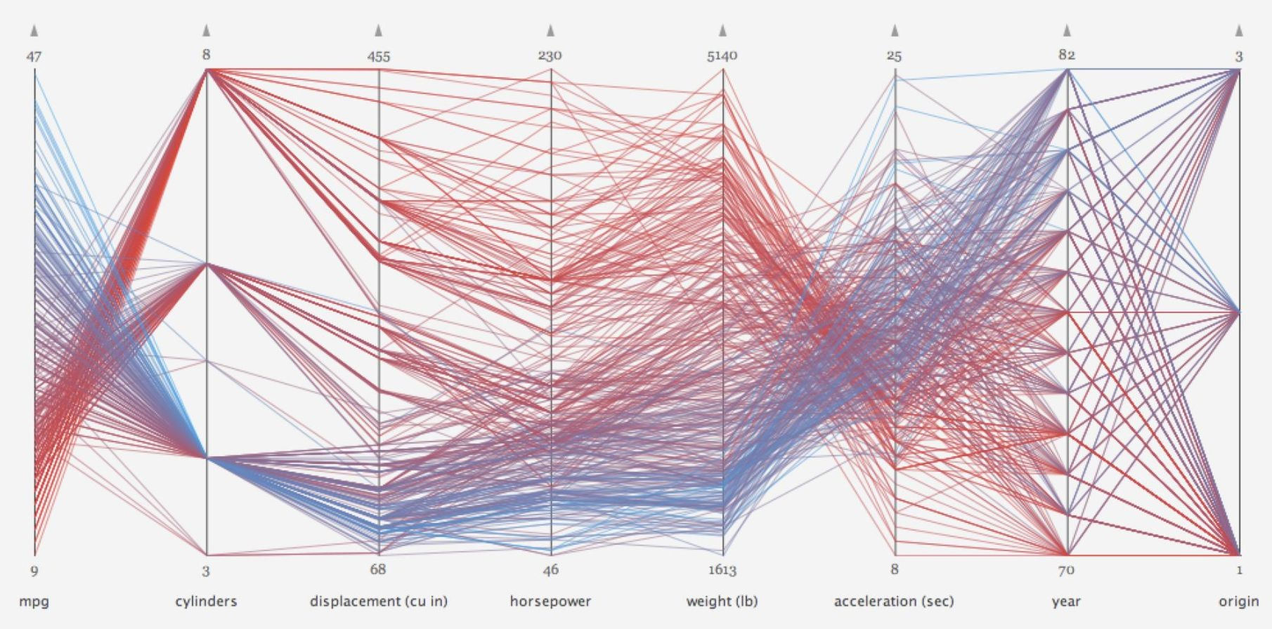
3. Rendering

Slide 15
4. Perceiving

Slide 16
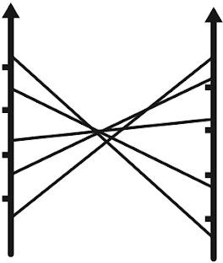
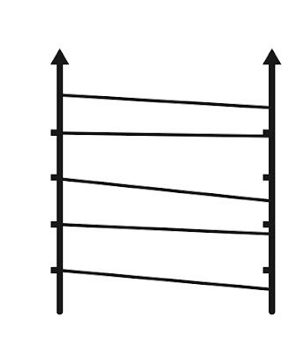
5. Interpretation
Negative Correlation
Positive Correlation

Slide 17
Encoding: designer
Decoding: user
Comprehending
What does it mean for me?
What shall I do now? Is this all true?
What do I learn?
1
Data
6
What is my data?
Which data type?
Ordinal / numerical / categorical?
Visual Mapping
What is my visual representation? Which visual variables am I using? How am I encoding my data?
fi
Interpreting
What does it mean? What does color mean? Wha does 'up 'mean?
What do these patterns show?
5
Rendering
What is my medium? monoscopic/stereoscopic? Tangiblity?
Print / digical?
3
4
Perceiving
What does it show?
Where is big, medium, small? How do things compare?
What relationships exist?
View

Slide 18
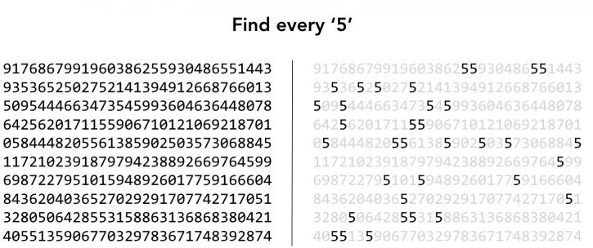

Slide 19
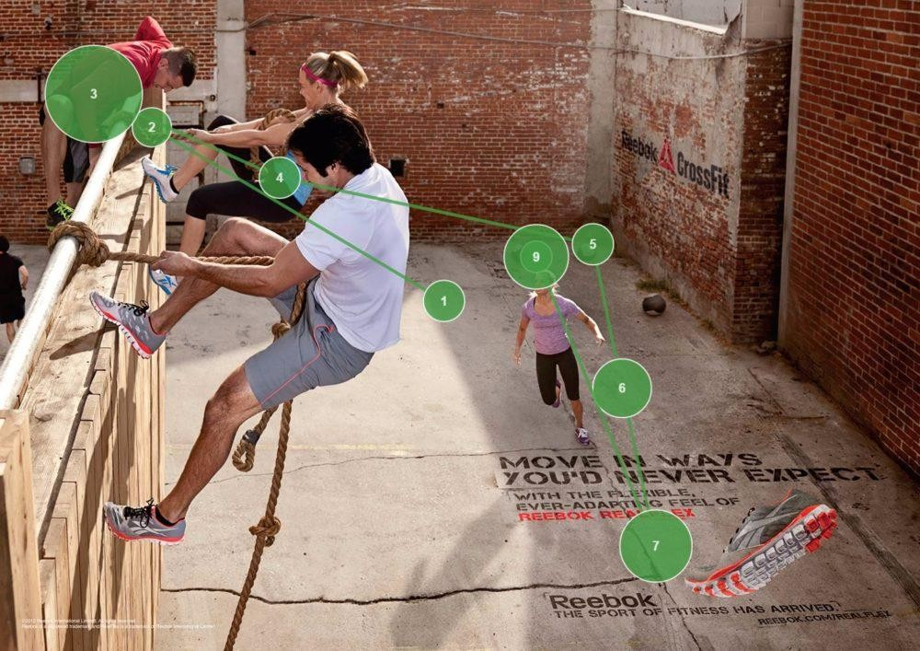
Pre-attentiveness:
"is the subconscious accumulation of information from the environment"
realizing something before you think
Parallelity:
- Perceiving stimuli in parallel

Slide 20
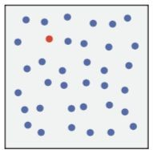

Slide 21
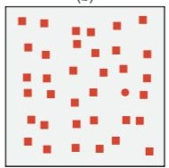

Slide 22
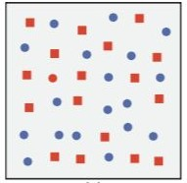

Slide 23


Slide 24
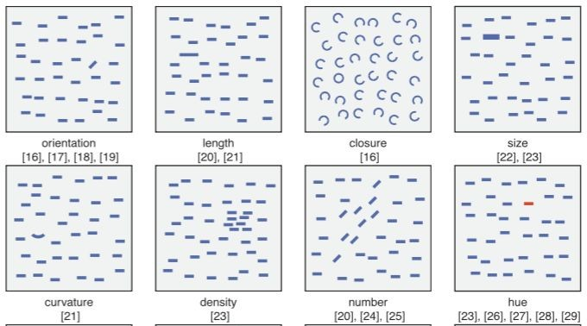
Preattentiveness

Slide 25
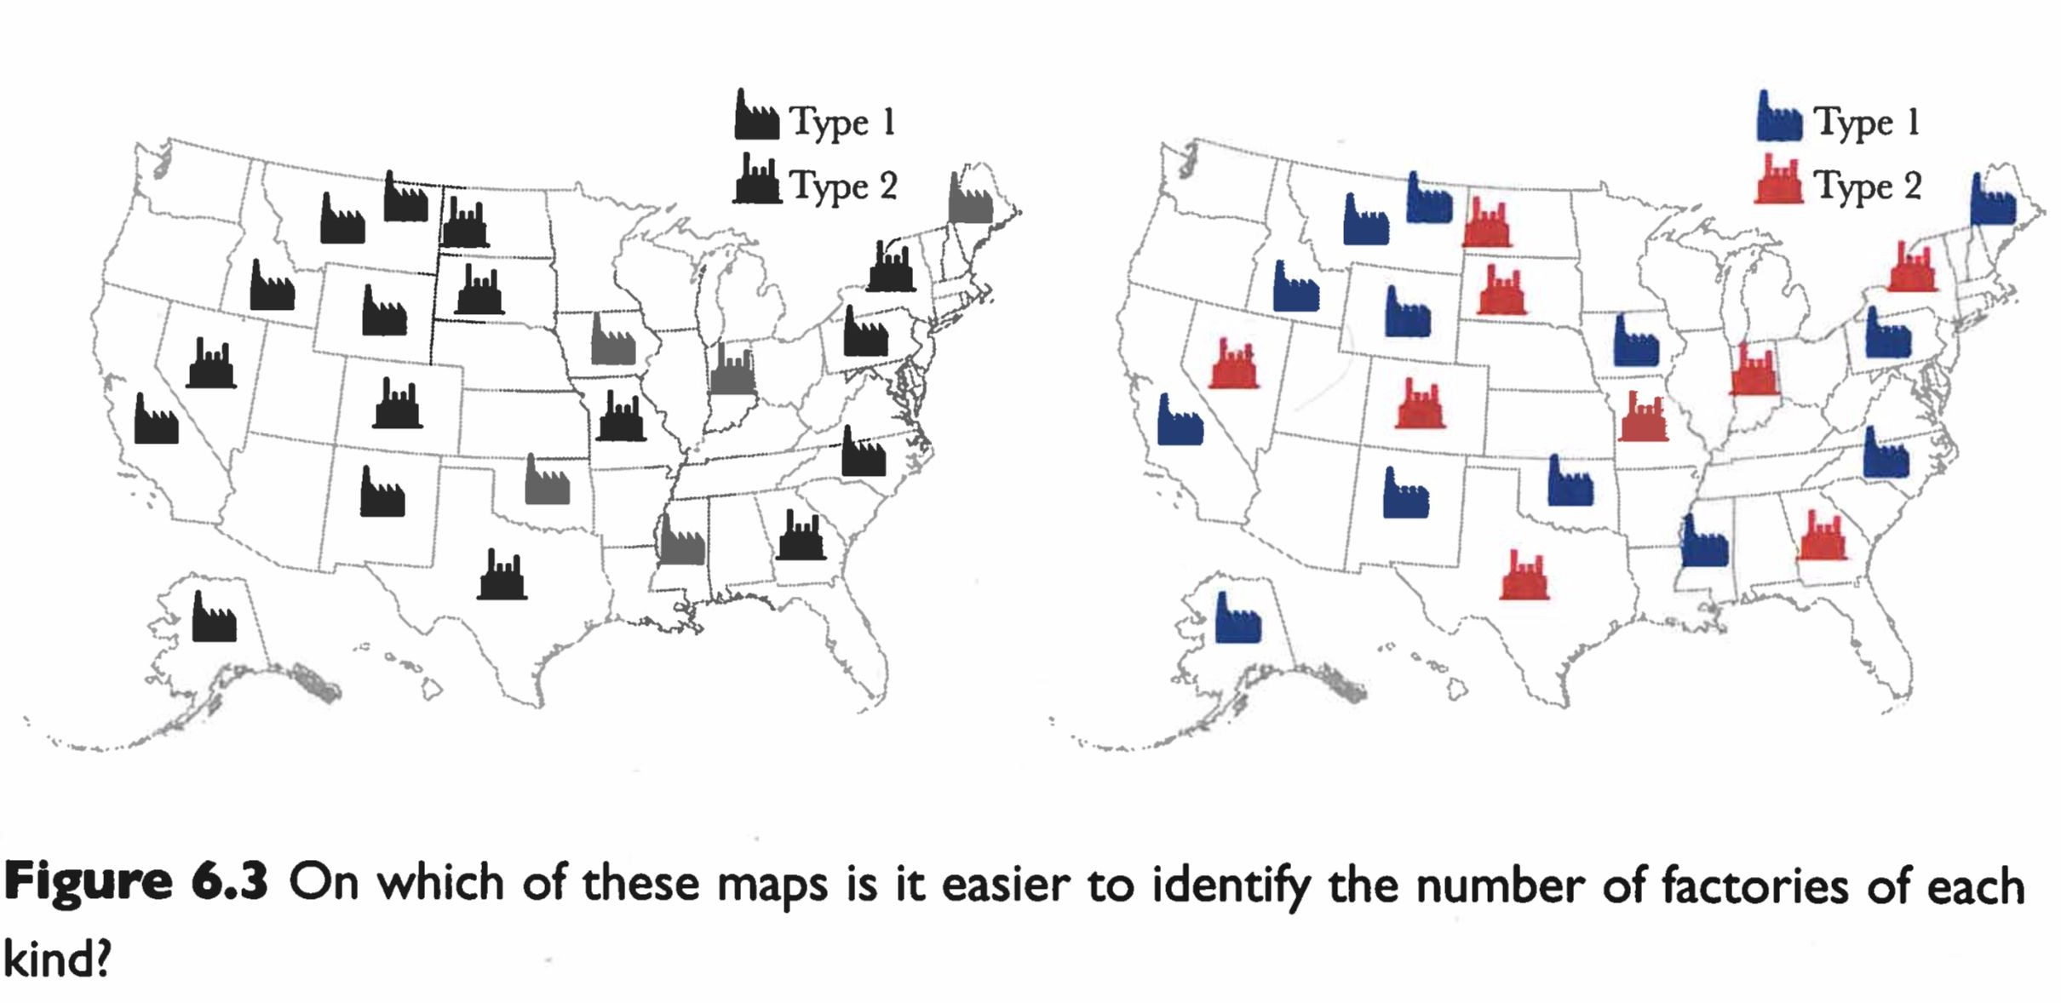

Slide 26
Gestalt Laws

Slide 27
Law of Similarity

Slide 28
Law of Closure

Slide 29
Law of Proximity

Slide 30
Law of Enclosure

Slide 31
Law of Continuity

Slide 32
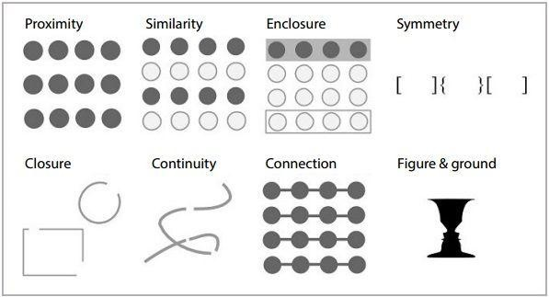
Gestalt Laws

Slide 33
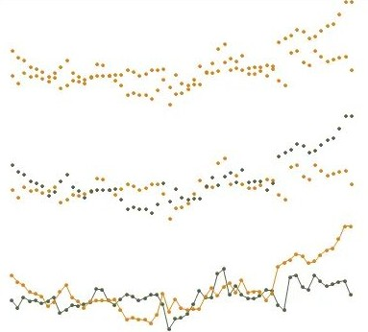
Gestalt Laws

Slide 34
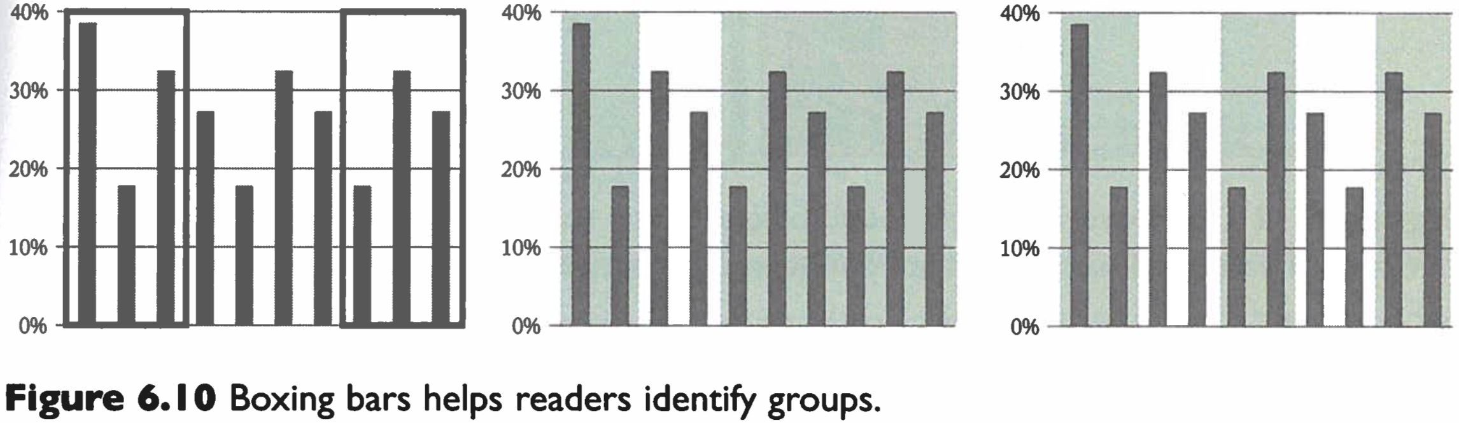
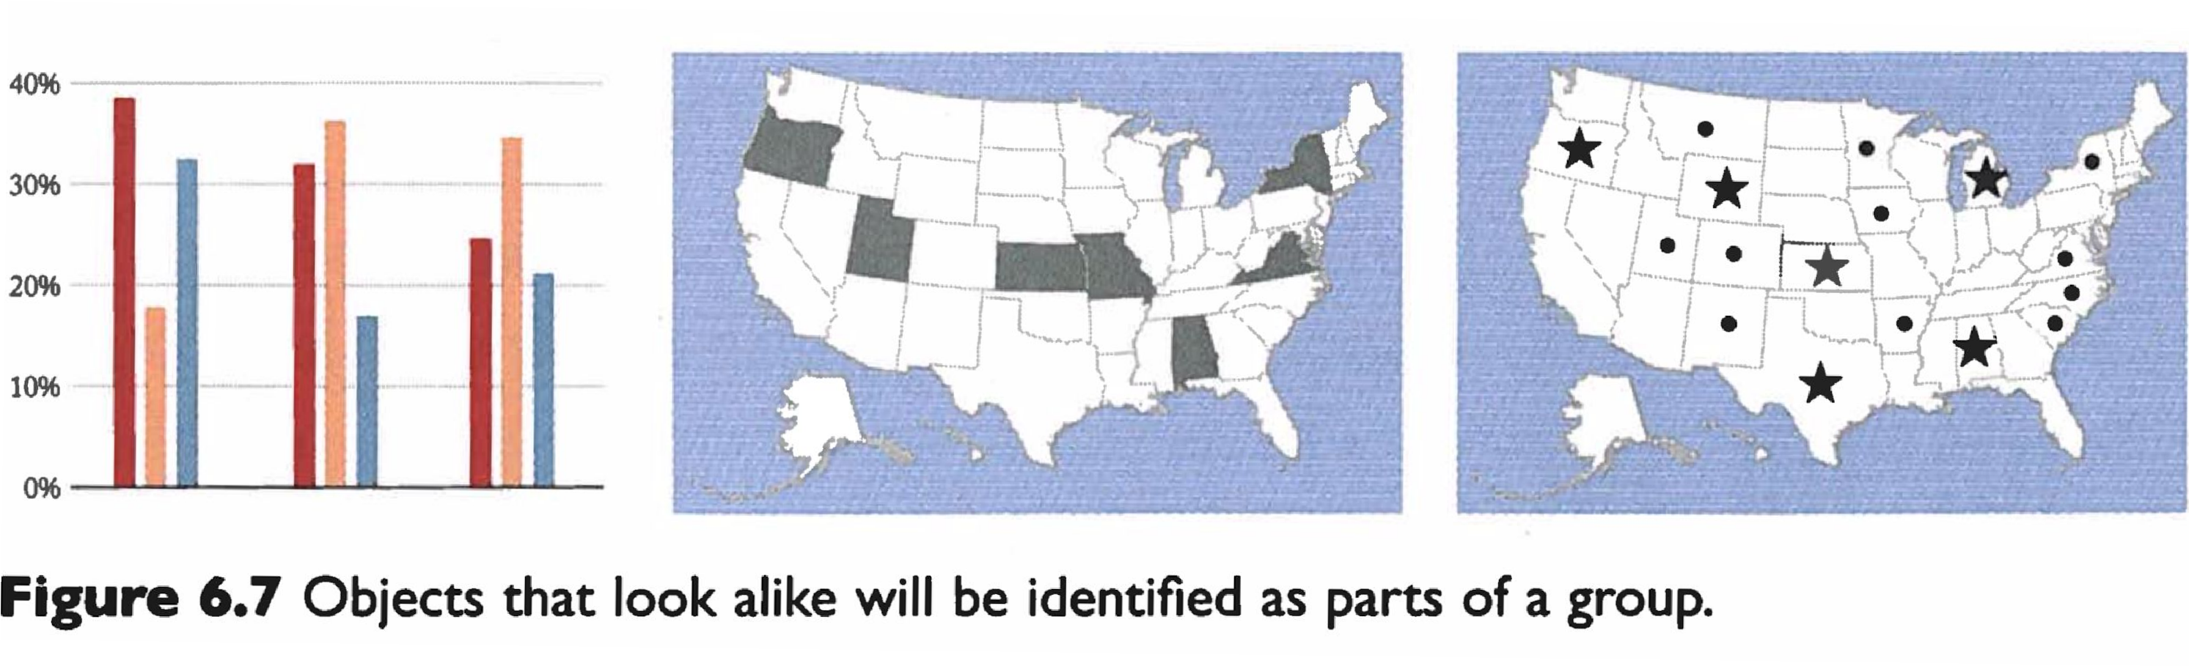

Slide 35
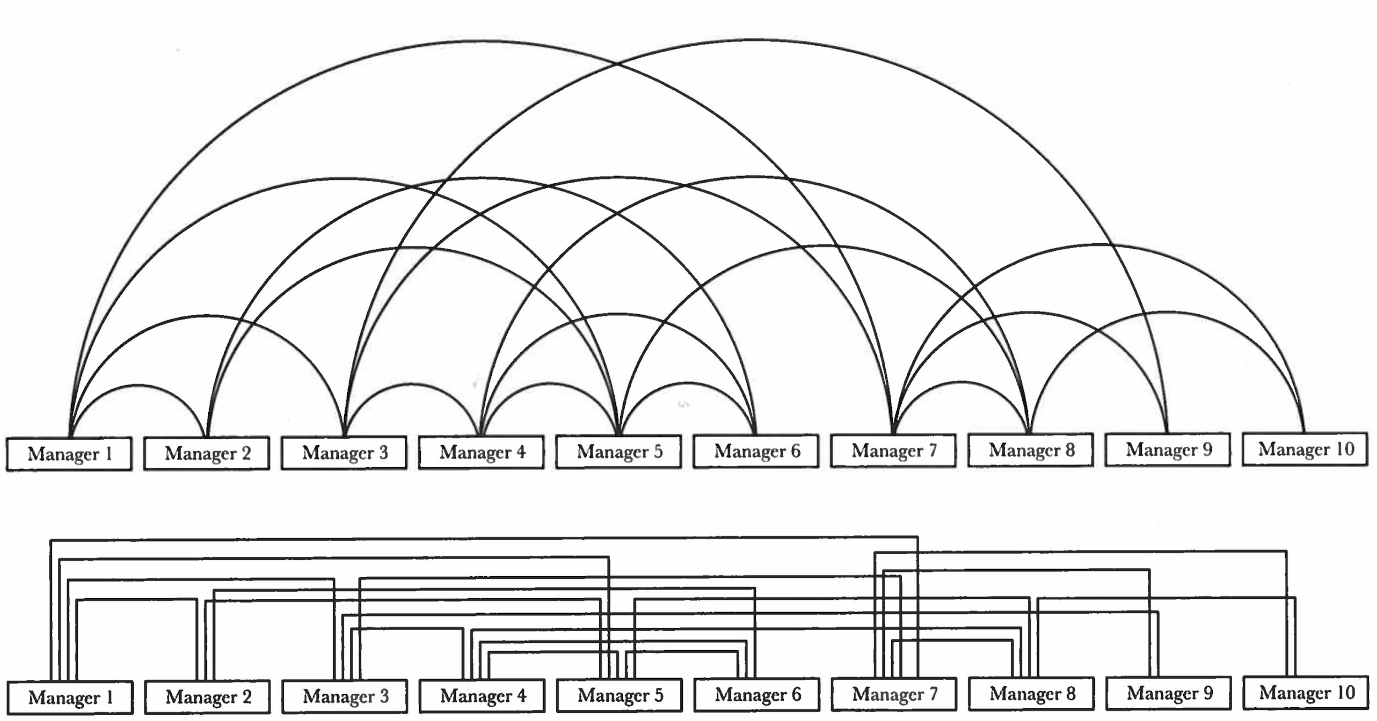
Continuity for line following

Slide 36
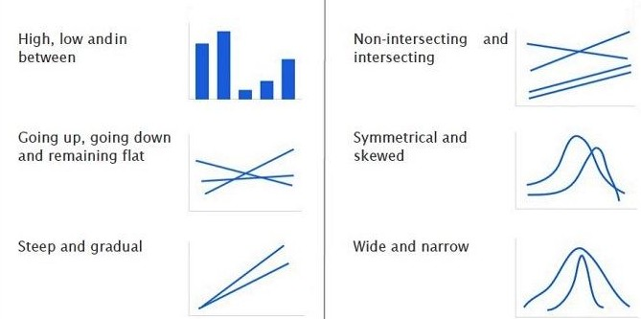
Visual Patterns

Slide 37
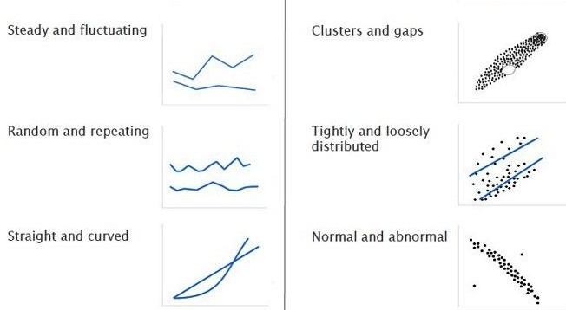
Visual Patterns

Slide 38
Encoding: designer
Decoding: user
Comprehending
What does it mean for me?
What shall I do now? Is this all true?
What do I learn?
1
Data
6
What is my data?
Which data type?
Ordinal / numerical / categorical?
Visual Mapping
What is my visual representation? Which visual variables am I using? How am I encoding my data?
fi
Interpreting
What does it mean? What does color mean? Wha does 'up 'mean?
What do these patterns show?
5
Rendering
What is my medium? monoscopic/stereoscopic? Tangiblity?
Print / digical?
3
4
Perceiving
What does it show?
Where is big, medium, small? How do things compare?
What relationships exist?
View

Slide 39
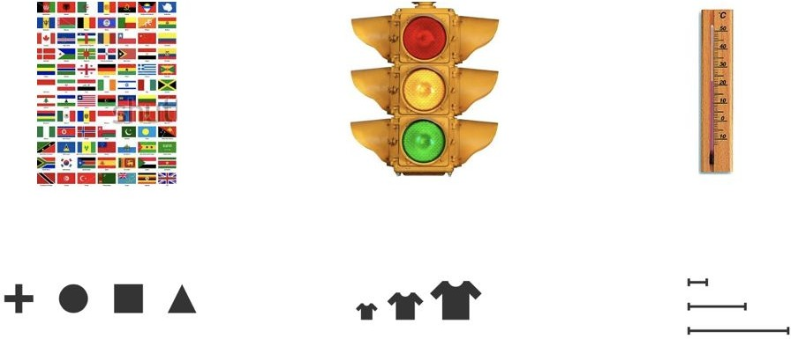
Data Types
Categorical
(Qualitiative)
Ordered
Numerical
(Quantitative)

Slide 40
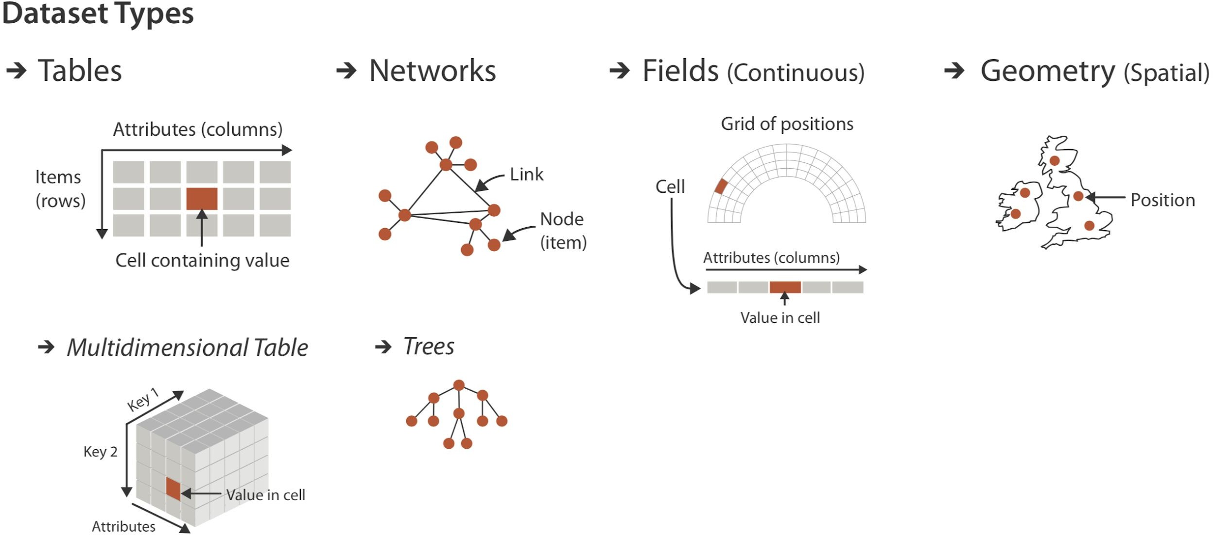

Slide 41
Encoding: designer
Decoding: user
Comprehending
What does it mean for me?
What shall I do now? Is this all true?
What do I learn?
1
Data
6
What is my data?
Which data type?
Ordinal / numerical / categorical?
fi
Visual Mapping
Interpreting
What does it mean? What does color mean? Wha does 'up 'mean?
What do these patterns show?
5
What is my visual representation? Which visual variables am I using? How am I encoding my data?
Rendering
What is my medium? monoscopic/stereoscopic? Tangiblity?
Print / digical?
3
4
Perceiving
What does it show?
Where is big, medium, small? How do things compare?
What relationships exist?
View

Slide 42
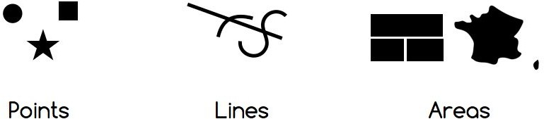
Visual Marks

Slide 43
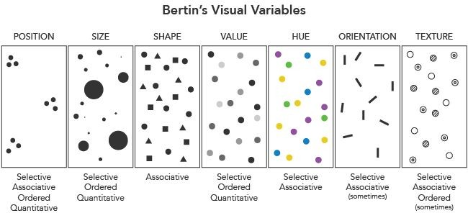
Visual Variables

Slide 44
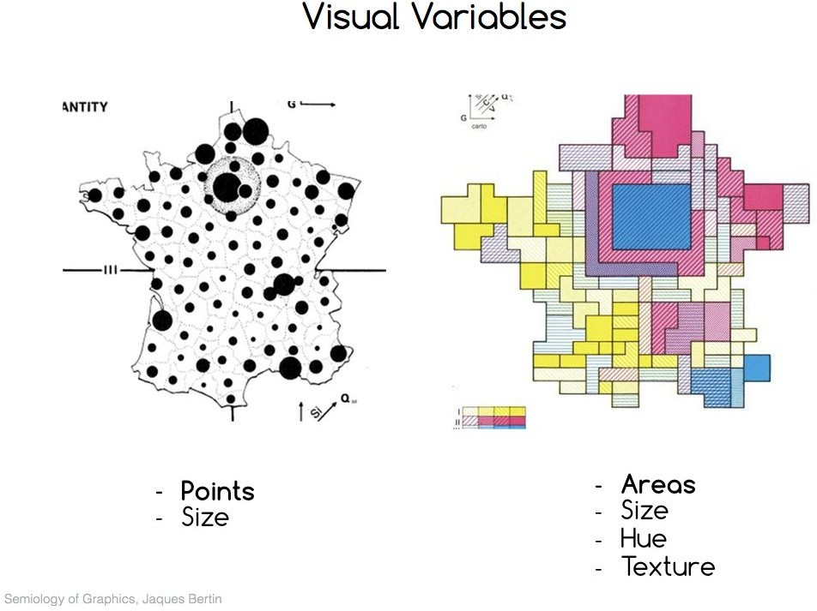

Slide 45
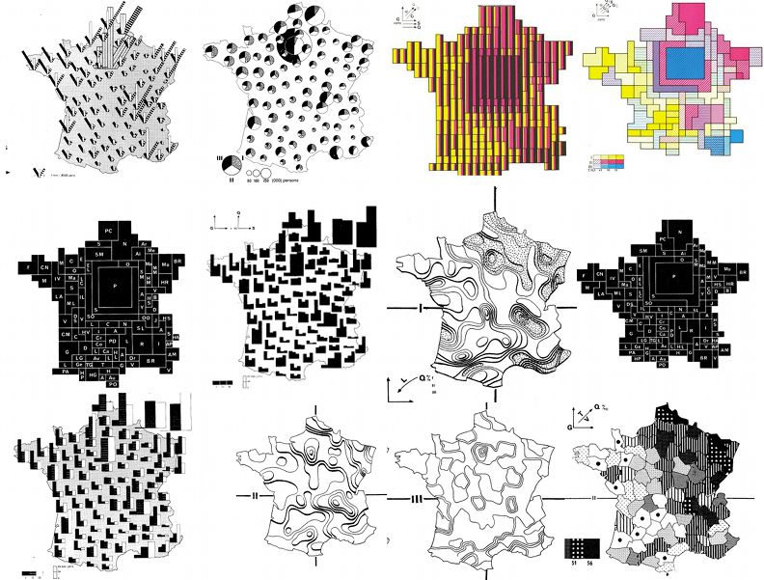

Slide 46
Characteristics of Visual Variables
Selective: Does it make a mark distinguishable?
Associative: Can I group marks? Quantitative: Can I do maths with it? Order: Does it imply an order on the marks?
Length: How many values does the variable has?

Slide 47
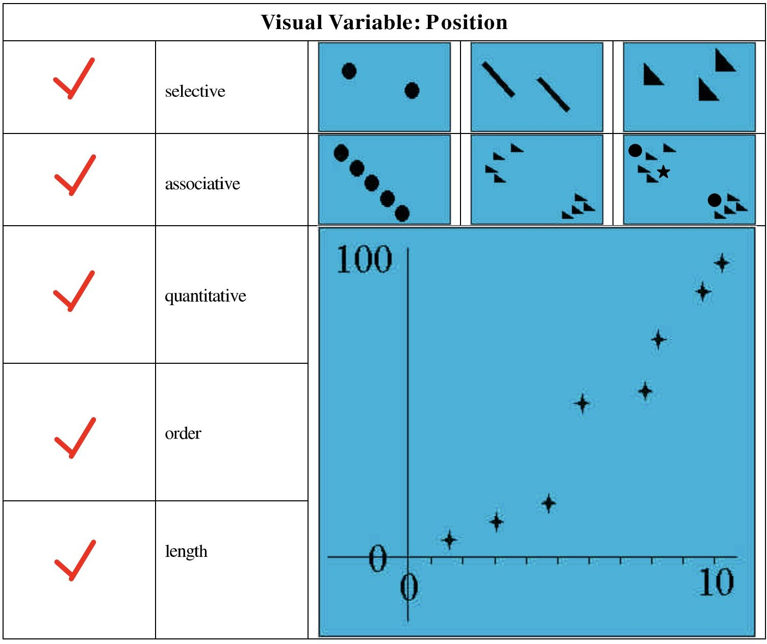

Slide 48
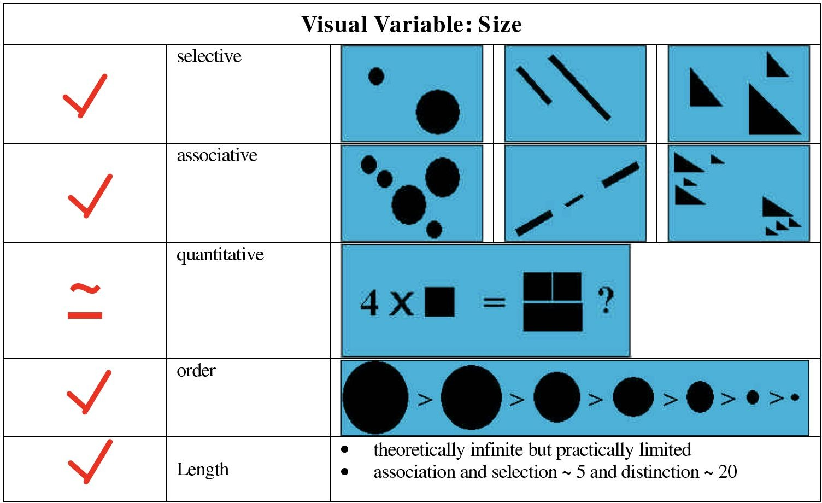

Slide 49
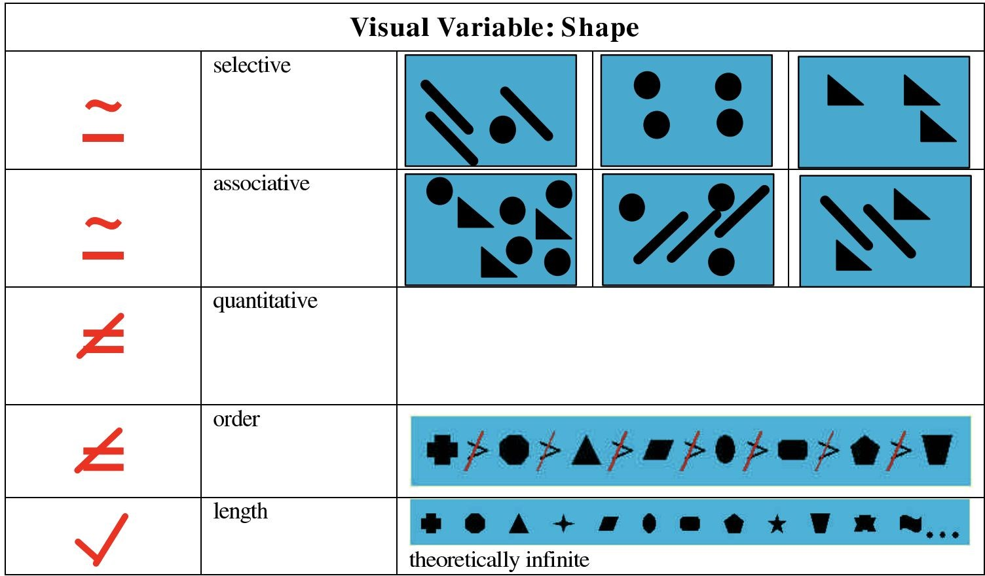

Slide 50
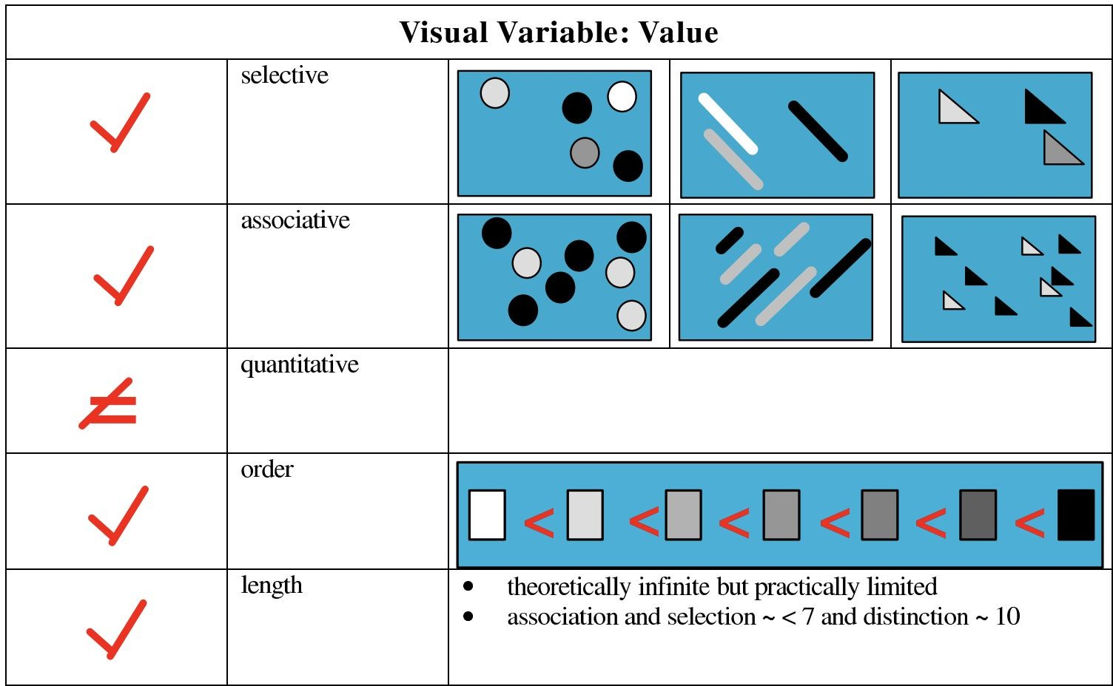

Slide 51
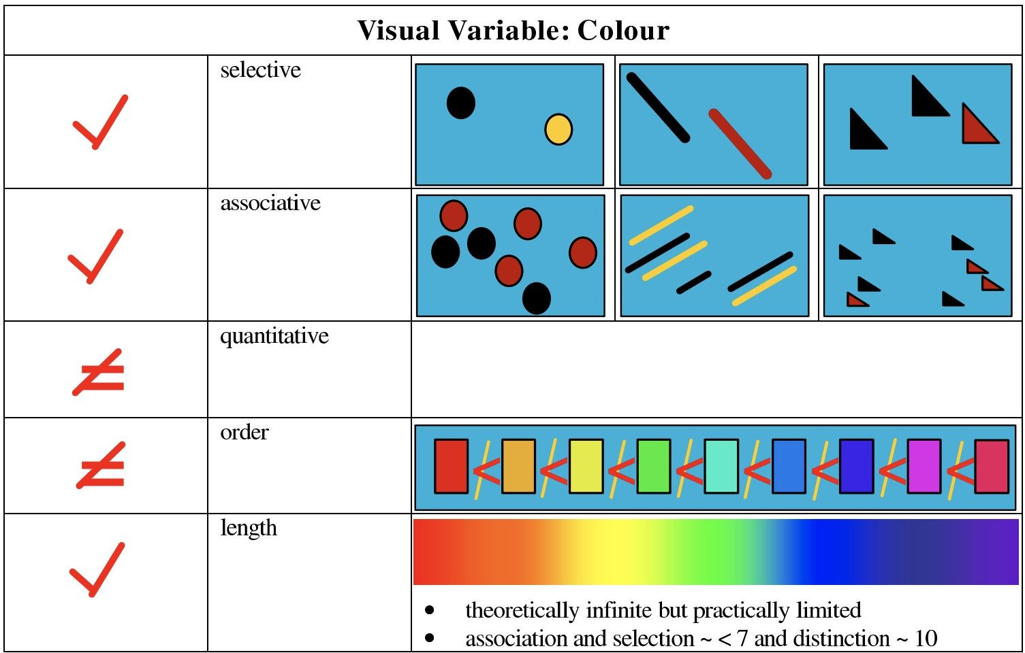
http://innovis.cpsc.ucalgary.ca/innovis/uploads/Publications/Publications/Carpendale_visual_variables.pdf

Slide 52
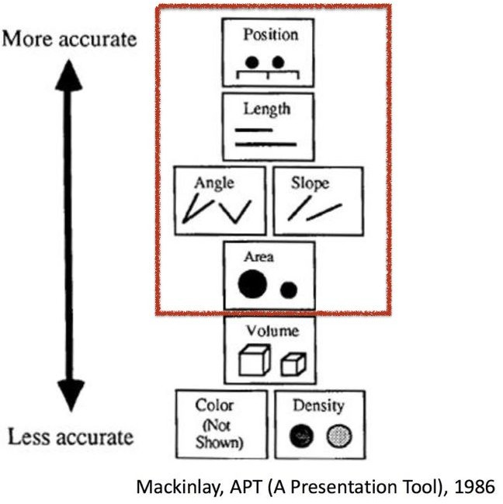

Slide 53
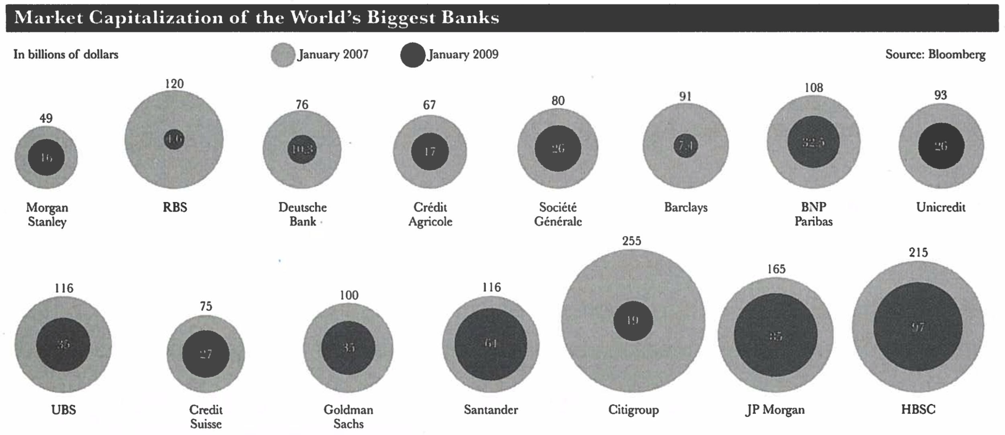

Slide 54
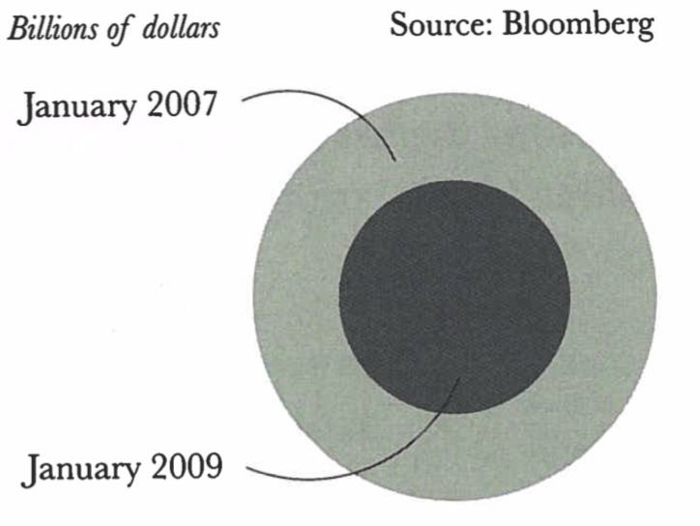
How to decode bubbles?
a)
b)
c)

Slide 55
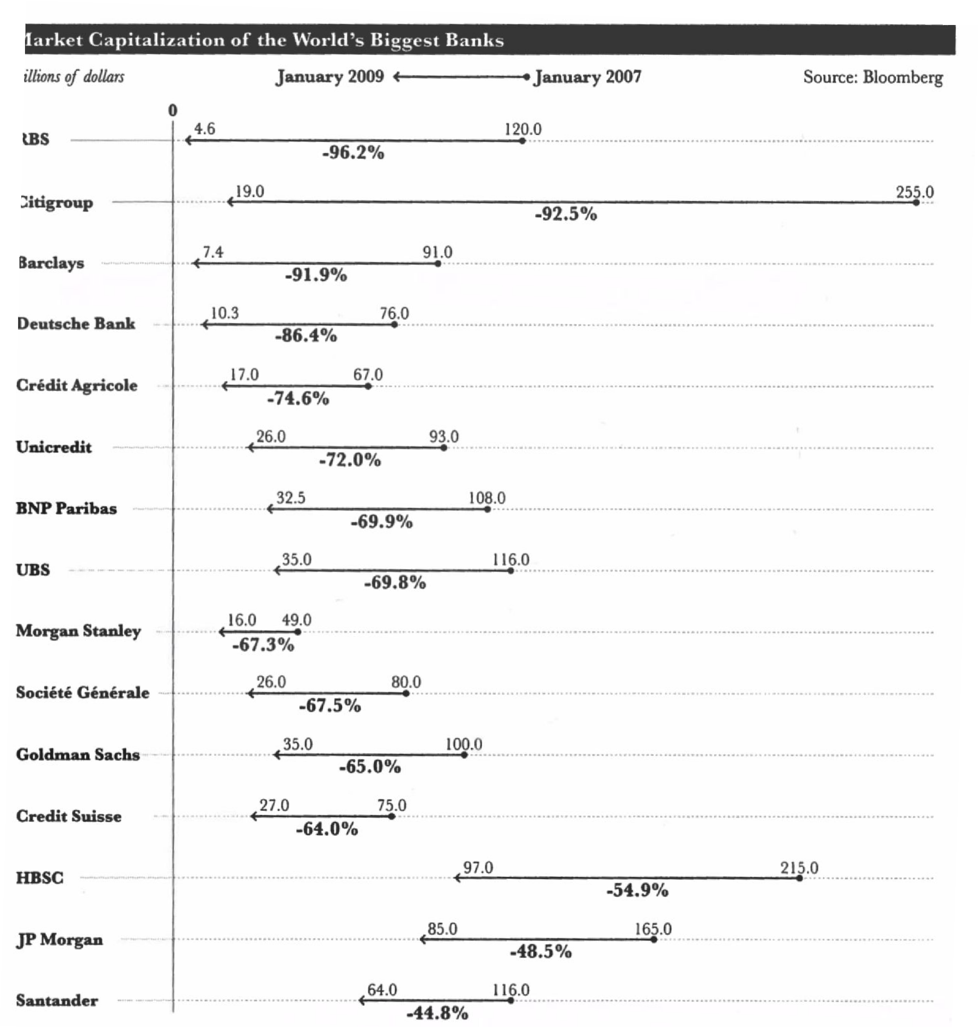

Slide 56
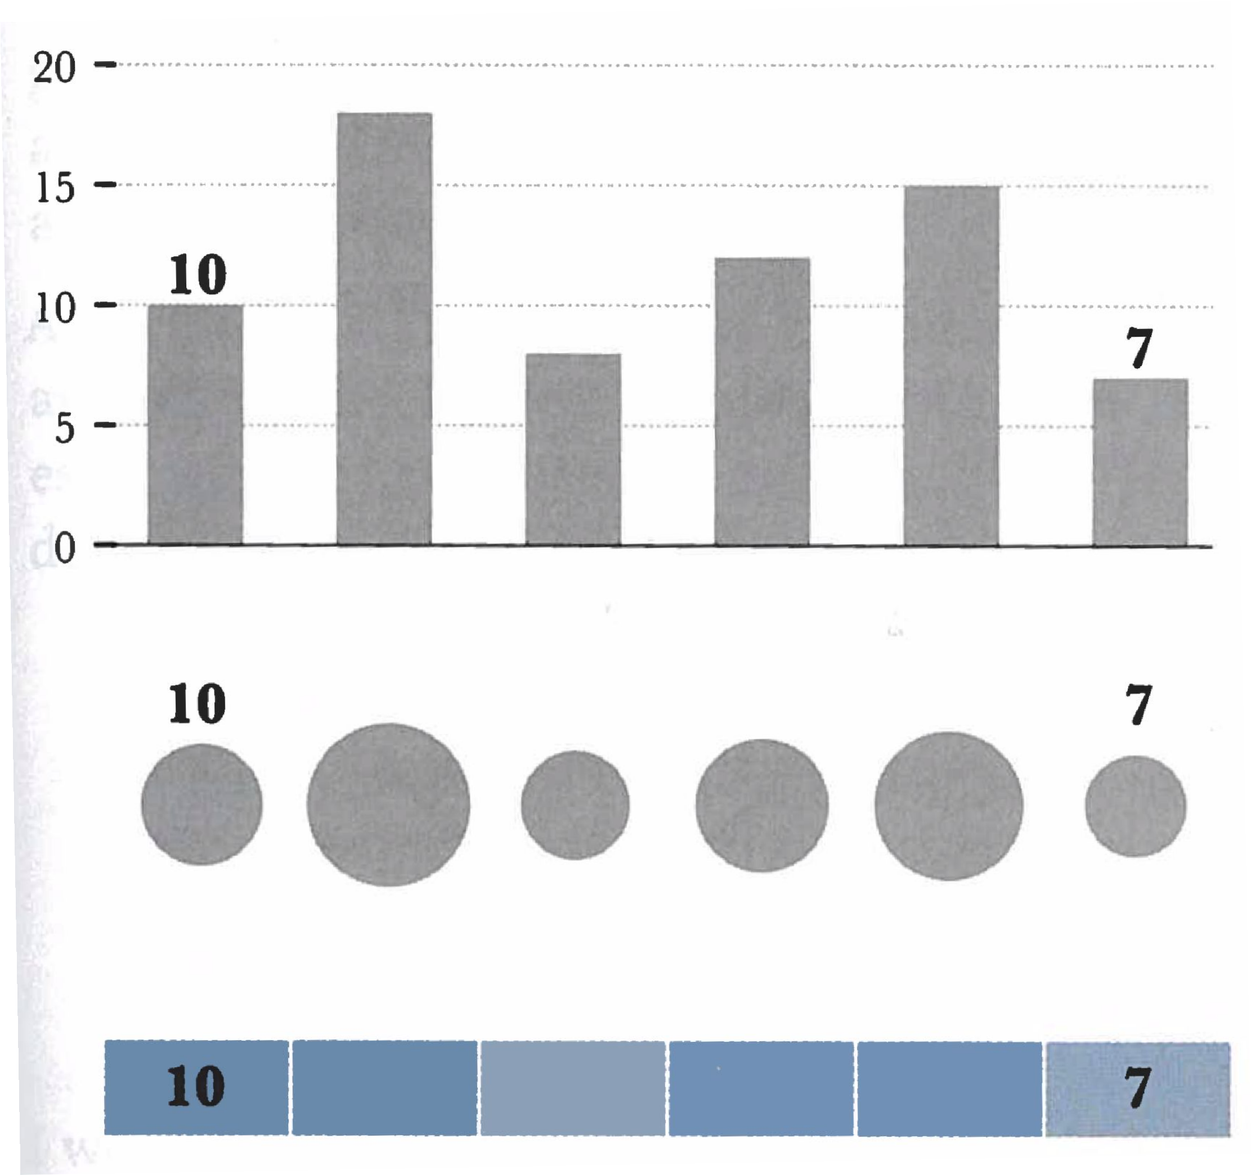

Slide 57
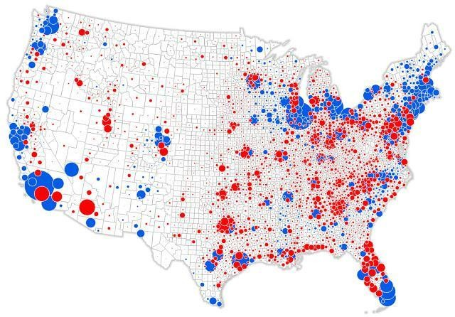

Slide 58
Summary
This lecture introduces the basics concepts of data visualizaion:
Why are we using data visualization?
Why does visualization work?.
The lecture includes topics such as perception and color and concepts such as exploratory data analysis, data-driven storytelling, visual variables, visual mappings, visualization pipeline, visualization techniques, visual representation, and visualization literacy.

Slide 59
Recommended Reading
Tamara Munzner: Visualization Analysis and Design
Chapter 2. What: Data Abstraction
Chapter 5. Marks and Channels
Alberto Cairo: The Functional Art
Chapter 1: Why Visulize: From Information to Visdom
Chapter 2: Forms and Functions: Visualization as Technology
Andy Kirk: Data Visualization
Chapter 1: Defining Data Visualization
Jaques Bertin: Semiology of Graphics
II.C: The retinal variables
Cleveland & MaGill: Graphical Perception: Theory, Experimentation, and Application to the Development of Graphical Methods, 1984

Slide 60


You most learn !!!
Basic
https://www.tableau.com/learn/articles/data-visualization

Slide 61

Improve yourself.
https://numpy.org/doc/stable/reference/arrays.indexing.html
1
https://www.w3schools.com/python/numpy_array_indexing.asp#:~:text=Array%20indexing%20is%20the%20same,second%20has%20index%201%20etc.
2
https://www.geeksforgeeks.org/indexing-in-numpy/
3
https://www.pluralsight.com/guides/working-numpy-arrays-indexing-slicing-guide
4
https://www.tableau.com/learn/articles/data-visualization
https://scipython.com/book/

Slide 62

ANY QUESTIONS?

